Slide 1
Dijkstra’s vs Bellman–Ford
The Single-Source Shortest Path

Slide 2
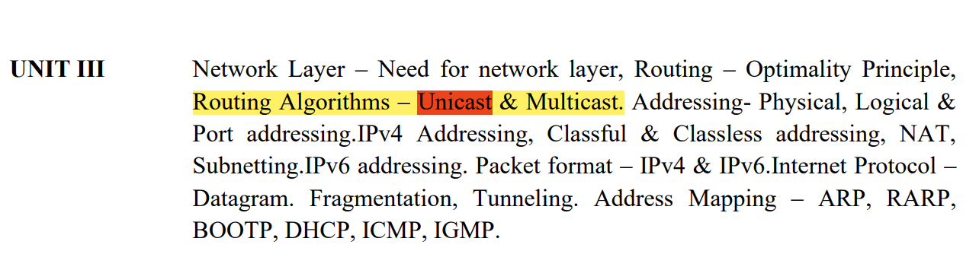

Slide 3
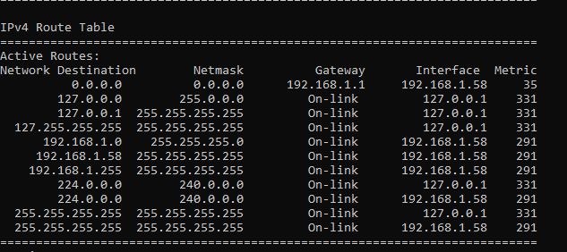
Some Basics…
Each time a router receives a packet it inspects the destination IP address and tries to find, by looking in its routing table, a possible route to that IP address.
Command:
netstat -r

Slide 4
Routing Protocols
Unicast
Multicast
Distance Vector
Link Sate
DVMRP
MOSPF
CBT
PIM
RIP
IGRP
EIGRP
OSPF
IS-IS

Slide 5
Distance Vector vs Link State
In distance vector routing the routers receive the topological information from the neighbour point of view.
On the contrary, in link state routing the router receive complete information on the network topology.
Bellman-Ford algorithm is used for performing distance vector routing whereas Dijkstra's is used for performing the link state routing.

Slide 6
The Single-Source Shortest Path
The Single-Source Shortest Path (SSSP) problem consists of finding the shortest paths between a given vertex v and all other vertices in the graph.

Slide 7
Dijkstra's algorithm
solves the single-source shortest path problem with non-negative edge weight.
Greedy approach : find the next best solution hoping that the end result is the best solution for the whole problem.

Slide 8
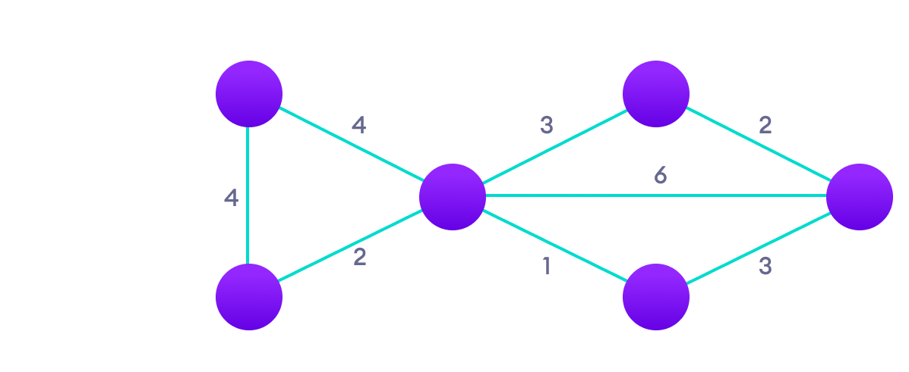
Img src:
https://www.programiz.com/dsa/dijkstra-algorithm
Relaxation
Choose initial Vertex and initiate 0
Mark cost on nearest vertices and ∞ for the rest.
Choose shortest of the vertex
Relax other vertices connected to it
Repeat 3 and 4 until all vertices are chosen
If d[u]+c(u, v) < d[v]:
d[v] = d[u]+c(u, v)

Slide 9
What if there is negative weight ?
8
A
D
2
-6
B
C
3

Slide 10
What if there is negative weight ?
1
A
D
2
-6
B
C
3

Slide 11
Bellman–Ford algorithm
When there is negative weights, the Dijkstra's algorithm may fail
Bellman–Ford algorithm solves the single-source problem if edge weights may be negative.
It is similar to Dijkstra's algorithm but it can work with graphs in which edges can have negative weights.

Slide 12
1
A
D
Create a list of edges
Mark initial vertex 0 and all others ∞
Visit one by one in order
Make relaxations if there any
Repeat 2 and 3 for at most v-1 times
(v is no of vertices in the graph)
2
-6
B
C
3

Slide 13
1
A
D
1
2
-6
B
C
3

Slide 14
Negative Loops
1 + 3 + (-6) = -2
When it comes to negative loops, Bellman ford algorithm will fail to reach the solution.
We can detect negative loops using extra iterations.
1
A
D
1
2
-6
B
C
3

